Slide 1

CSPCI-400 Project
Video Captioning Bot
SUBMITTED BY: MENTORED BY:
Kartik Karira(18103051) Dr. Avtar Singh
Rohit Mittal (18103081) (Assistant Professor)
CSE Department
Department of Computer Science and Engineering
Dr B R Ambedkar National Institute of Technology Jalandhar

Slide 2
Table of Contents
Overview
Problem Statement
Proposed Solution
Tech Stack
Dataset Description
Model Architecture
Concepts Used
Working
Results
Testing

Slide 3

OVERVIEW
Developing a Machine Learning based approach using OpenCV and python libraries which could provide suitable captions for actions happening in video/gif given as input.

Slide 4
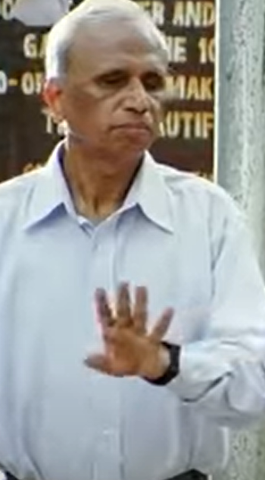
Problem Statement
Dealing with sight loss, already, is a challenge itself. Individuals with vision impairment are also more likely to experience restrictions in their independence, mobility as well as an increased risk of falls, fractures, injuries. So, if we could have a system which will pronounce everything what’s happening around them will help them in a very good manner.

Slide 5
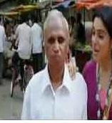
Proposed Solution
We propose a system having Deep Learning model using which blinds can know what they is happening in their surroundings. In this we will record videos of about 2-3 seconds

Slide 6
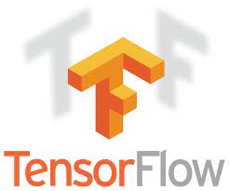




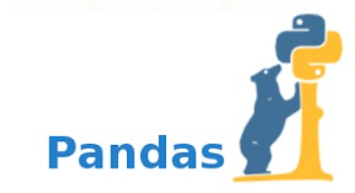

Tech Stack

Slide 7
Dataset Description
For the purpose of this study, we are using the MSVD(Microsoft Research Video Description Corpus) and MSR-VTT(Microsoft Research Video to Text) dataset created by Microsoft.
MSVD:
This dataset has about 1550 videos in which 1450 videos are used for training and validation and remaining 100 for the testing purpose.
MSR-VTT:
MSR-VTT is a large-scale dataset for the open domain video captioning, which consists of 10,000 video clips from 20 categories, and each video clip is annotated with 20 English sentences.

Slide 8
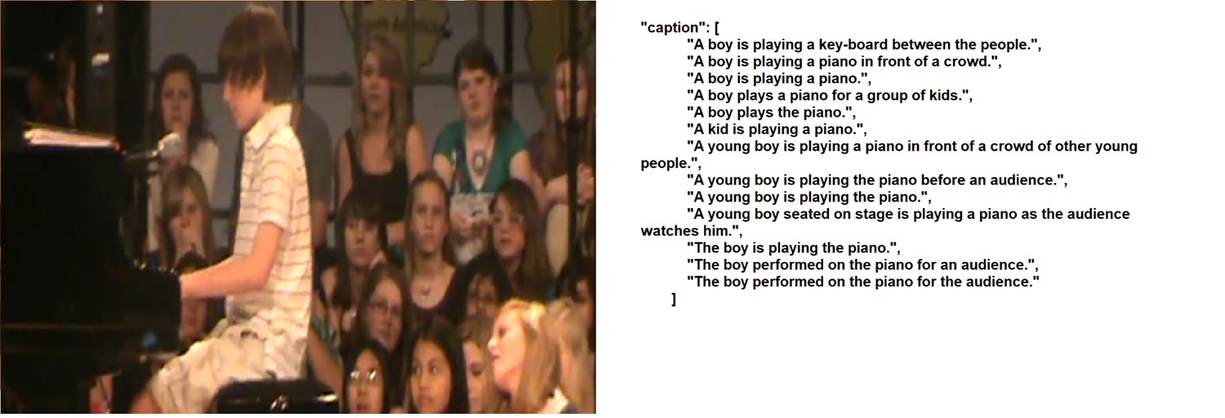
Example

Slide 9
Machine Learning Model: Architecture
Here we are using Multi-Model architecture composed of:
RNN(Recurrent Neural Network)
CNN(Convolutional Neural Network)
where CNN will be used for the feature extraction from the video and then the result is fed into a RNN for predicting a suitable caption for it.

Slide 10
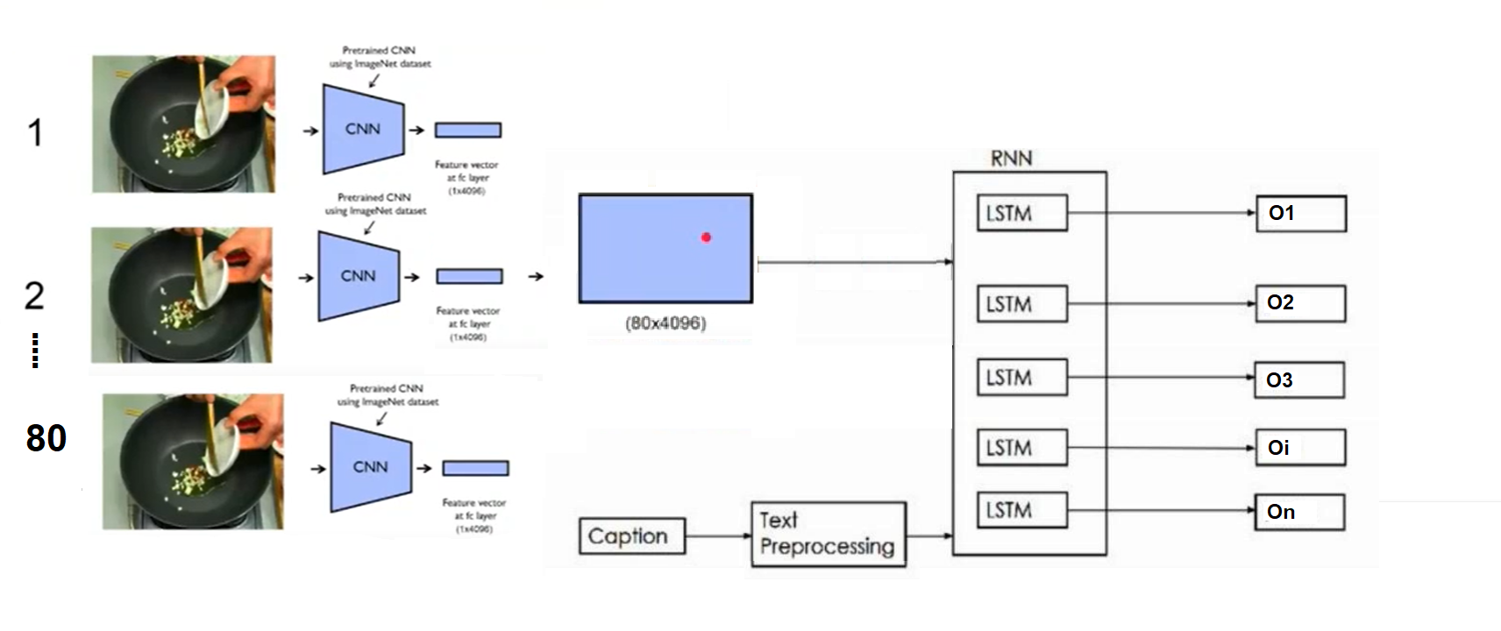
Flow

Slide 11
Concepts
Convolution Neural Network used in VGG16.
Long Short-Term Memory Recurrent Neural Network.
Text-Processing.

Slide 12
CONVOLUTIONAL NEURAL NETWORK (CNN)
CNN Are Very Similar To Ordinary Neural Networks.
Convnet Architectures Make The Explicit Assumption That The Inputs Are Images, Which Allows Us To Encode Certain Properties Into The Architecture.
It Has Filters, Pooling Layers Because Of The Assumption That Input Is Always An Image.
For Our Project We Are Using Vgg16 For Extracting The Features From Each Frame And Then Combining All The Frames Result For Our Work.

Slide 13
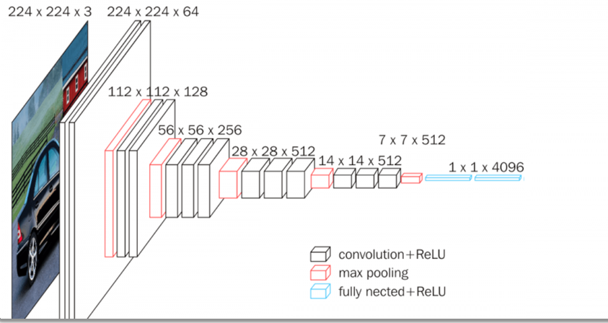
VGG16(VISUAL GEOMETRY GROUP)

Slide 14
RNN AND LSTM
Recurrent Neural Networks Are The State-Of-The-Art Algorithm For Sequential Data And Among Others Used By Apples Siri And Googles Voice Search.
It Has An Internal Memory Which Makes It Perfectly Suited For Machine Learning Problems That Involve Sequential Data Because It Can Remembers It’s Input.
For Our Project We Use LSTM As We Require A Sequence Of Words As An Output

Slide 15
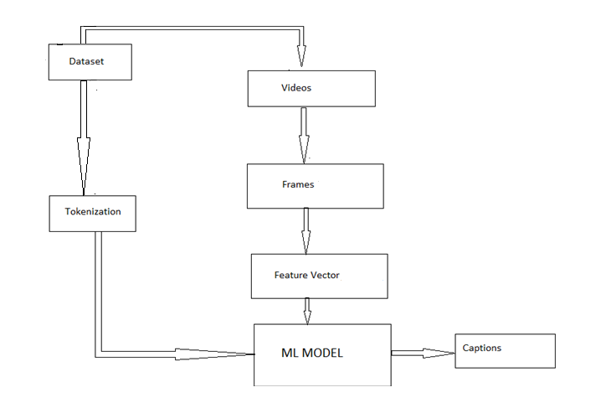
Working

Slide 16
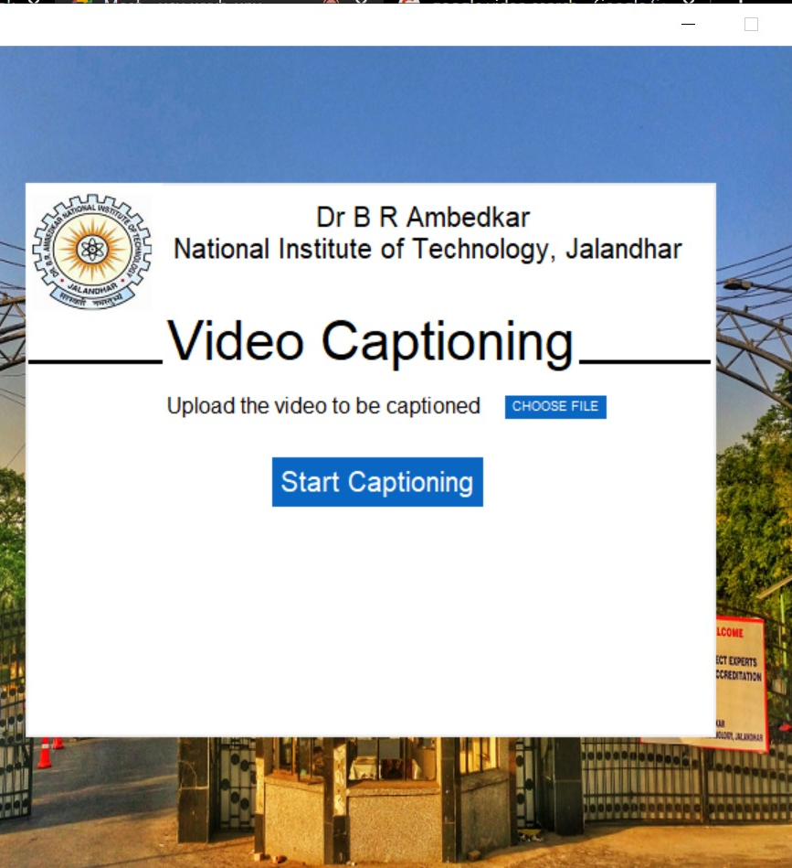
User Interface
On running the front.py the GUI below will pop up on screen.

Slide 17
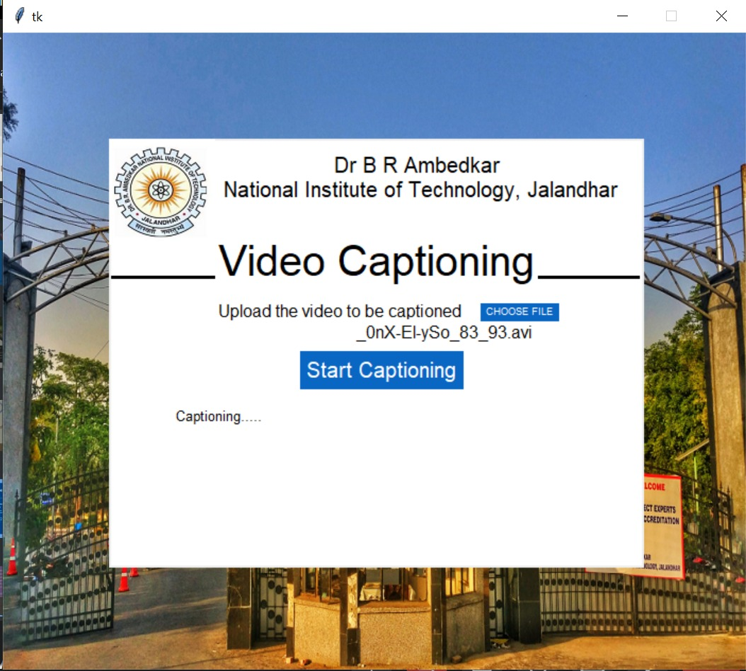
Now click on choose file and select the video to be captioned and click on Start Captioning.

Slide 18
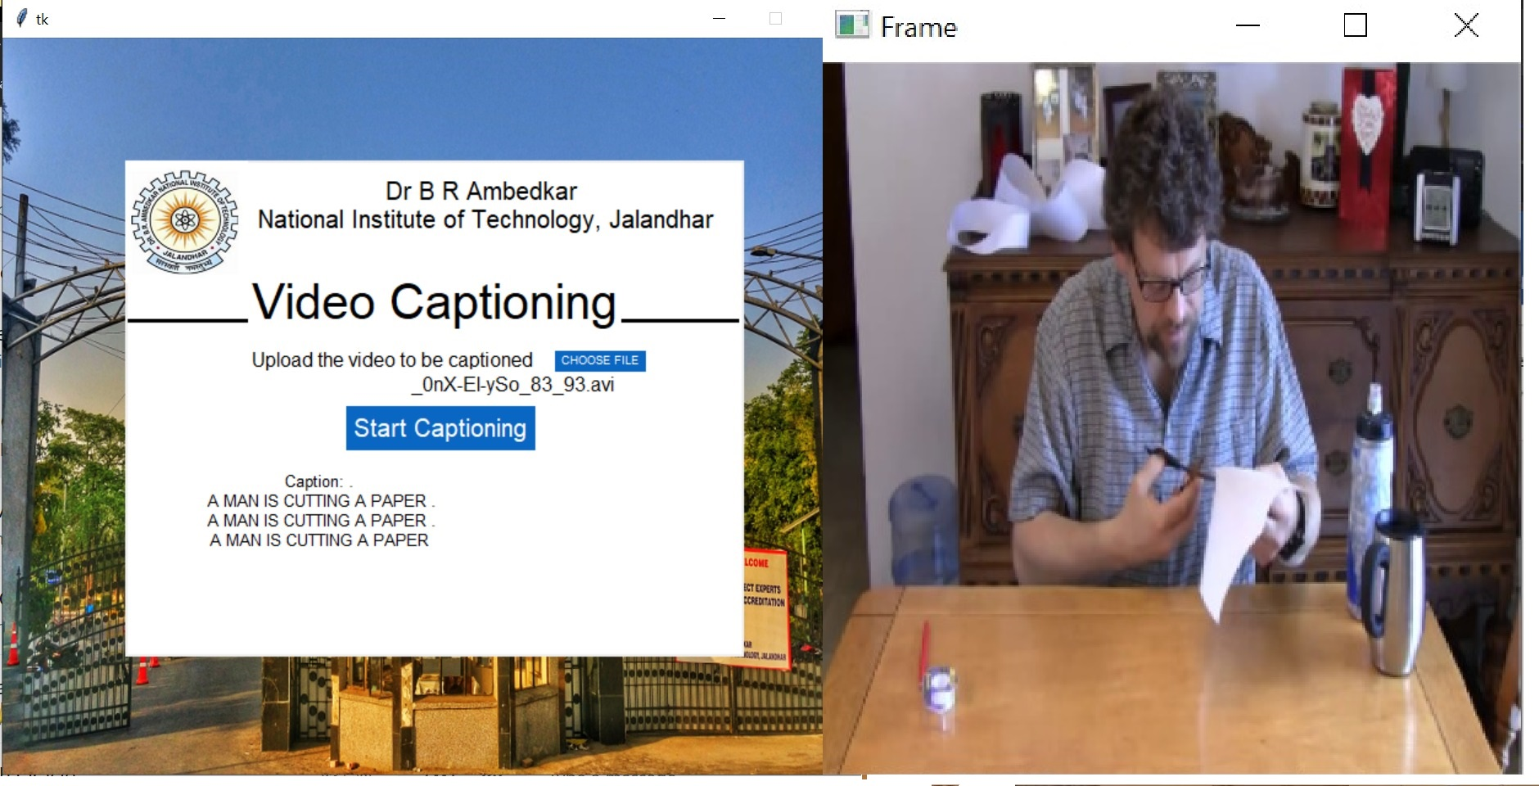
The output will show the captions generated by the model and will run the video in background and the caption will also be spoken out

Slide 19
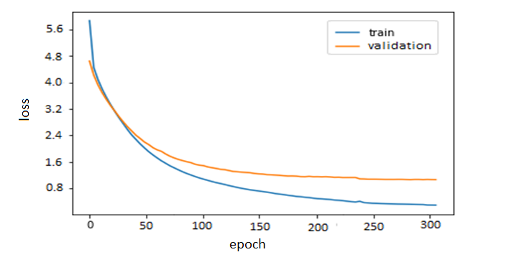
Results
We tracked the model's loss on the training set, as well as its performance on the validation set, during training.

Slide 20
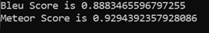
Continued….
For quantitative evaluation we have calculated BLEU and METEOR score which comes out to be:

Slide 21
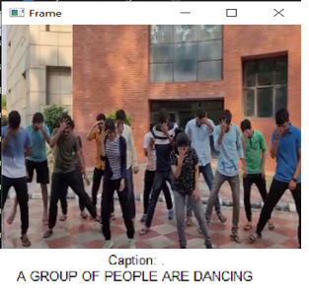
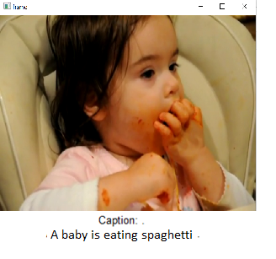
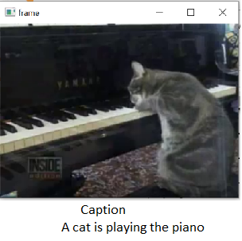
Testing Results
We will look at some of the result captioning

Slide 22


